Slide 1

LOW LEVEL DESIGN DOCUMENT
BANK MARKETING ANALYTICS
KRISHNA BIRADAR
VERSION: 1.0
DATED: 15/01/2023

Slide 2
Document Version Control:
Bank Marketing Analytics
Version | Date | Author | Change
1.0 | 02/02/2023 | Krishna Biradar | First version of complete LLD
1.1 | 02/02/2023 | Krishna Biradar | Added Power BI functionality and dashboard

Slide 3
Abstract:
The data is related to direct marketing campaigns (phone calls) of a Portuguese banking institution. This is a classification problem statement, main goal of this project is to predict if the client will subscribe to a term deposit or not. The data is related to direct marketing campaigns of a Portuguese banking institution. The marketing campaigns were based on phone calls. Often, more than one contact to the same client was required, in order to access if the product (bank term deposit) would be subscribed or not.

Slide 4
Contents:
1.Introduction ........................................................................................................... 05
1.1. What is Low-Level Design Document?................................................... 05
1.2. Scope ..................................................................................................... 05
2.Architecture .......................................................................................................... 05
3.Architecture Description ........................................................................................ 06
3.1. Data Sourcing .......................................................................................... 06
3.2. Data Overview ...................................................................................... ….07-08
3.3. Data Description ...................................................................................... 09-10
3.4. Data loading in Power BI Query Editor .................................................... 10-11
3.5. Data to Insights through Visualizations and Excel Data Analysis .......... …11-14

Slide 5
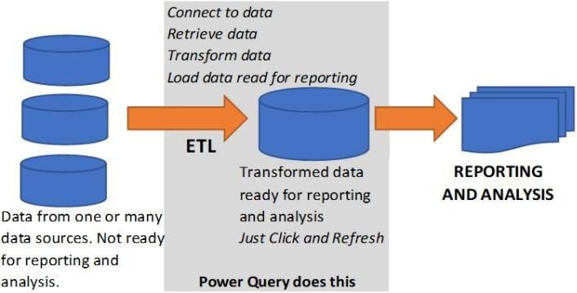
Introduction:
Why this Low-Level Design Document?
The goal of the LDD or Low-level design document (LLDD) is to give the
internal logic design of the actual program code for the Bank Marketing Campaign Analysis. LDD describes the class diagrams with the methods and relations between classes and programs specs. It describes the modules so that the programmer can directly code the program from the document.
Scope
Low-level design (LLD) is a component-level design process that follows a
step-by-step refinement process. The process can be used for designing data structures, required software architecture, source code and ultimately, performance algorithms. Overall, the data organization may be defined during requirement analysis and then refined during data design work.
Architecture:
ETL (extract, transform and load) in Power BI uses preparation of data sets for analysis by removing irregularities in the data. It also involves data visualization to draw meaningful patterns and insights.

Slide 6
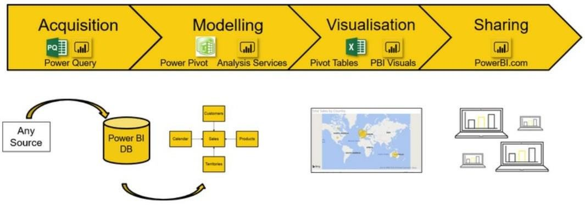
Based on the results of ETL, companies also make business decisions, which can have repercussions later.
If ETL is not done properly then it can damage the business a lot in many ways such as loss of client which we are working for, the decision making will go completely wrong and many more issues.
If done well, it may improve the efficacy of everything we do next.
Below are following steps to follow for ETL:
Data Sourcing
Data Cleaning
Data Modelling
Data Visualization
3. Architecture
Description:
3.1 Data Sourcing:
The dataset is in csv (comma separated values) format. MySQL Workbench is used to load the data.

Slide 7
Citation Request:
This dataset is publicly available for research. The details are described in [Moro et al.,
2014]. Please include this citation if you plan to use this database:
[Moro et al., 2014] S. Moro, P. Cortez and P. Rita. A Data-Driven Approach to Predict
the Success of Bank Telemarketing. Decision Support Systems, In press,
http://dx.doi.org/10.1016/j.dss.2014.03.001
Available at:
[pdf] http://dx.doi.org/10.1016/j.dss.2014.03.001
[bib] http://www3.dsi.uminho.pt/pcortez/bib/2014-dss.txt
Title: Bank Marketing (with social/economic context)
Sources: Created by: Sérgio Moro (ISCTE-IUL), Paulo Cortez (Univ. Minho) and Paulo Rita (ISCTE-IUL) @ 2014
Past Usage:
The full dataset (bank-additional-full.csv) was described and analyzed in:
S. Moro, P. Cortez and P. Rita. A Data-Driven Approach to Predict the Success of
Bank Telemarketing. Decision Support Systems (2014)
doi:10.1016/j.dss.2014.03.001.
3.2 Data Overview:
This dataset is based on "Bank Marketing" UCI dataset (please check the description at: http://archive.ics.uci.edu/ml/datasets/Bank+Marketing).
The data is enriched by the addition of five new social and economic features/attributes (national wide indicators from a ~10M population country), published by the Banco de Portugal and publicly available at: https://www.bportugal.pt/estatisticasweb.
This dataset is almost identical to the one used in [Moro et al., 2014] (it does not include all attributes due to privacy concerns).
Using the rminer package and R tool (http://cran.r- project.org/web/packages/rminer/), we found that the addition of the five new social and economic attributes (made available here) lead to substantial improvement in the prediction of a success, even when the duration of the call is not included. Note: the file can be read in R using:
d=read.table("bank-additional-full.csv",header=TRUE,sep=";")

Slide 8
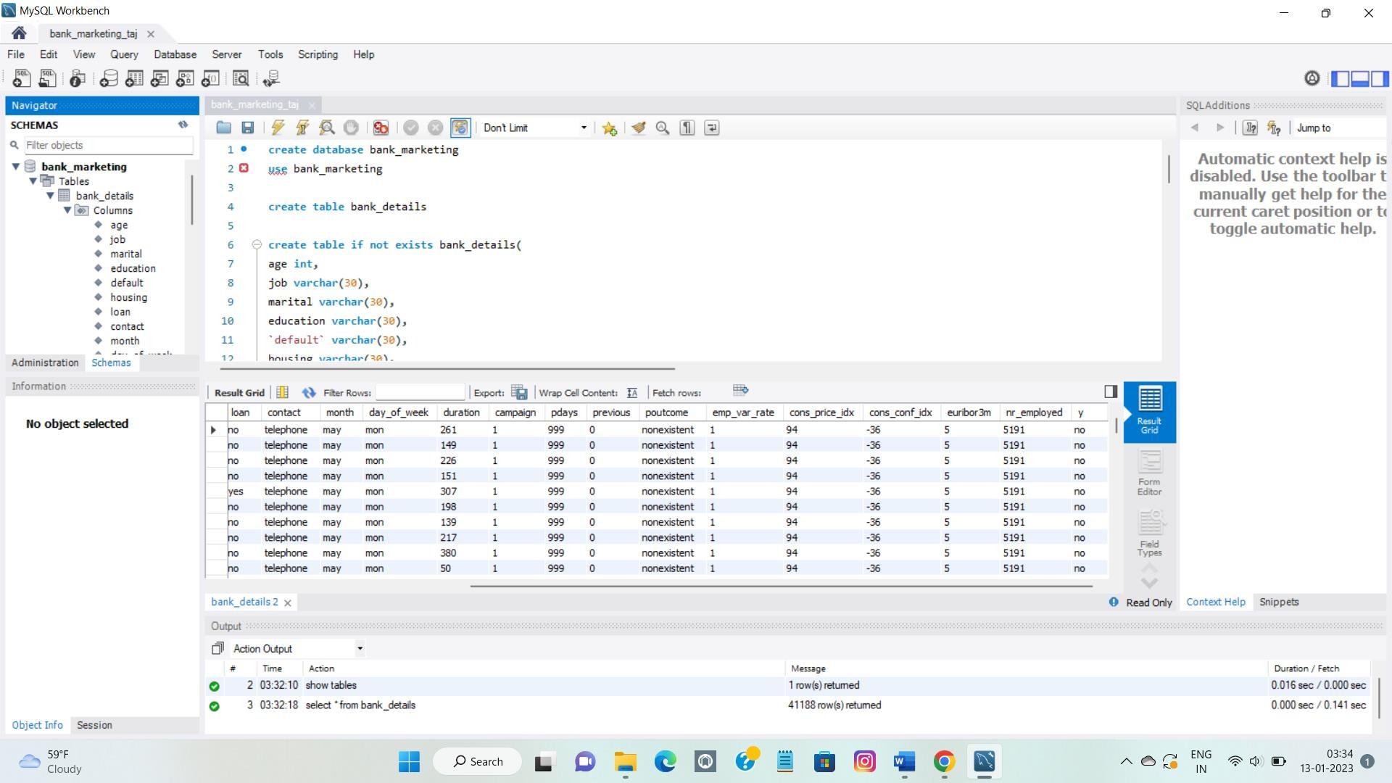
The zip file includes two datasets:
bank-additional-full.csv with all examples, ordered by date (from May
2008 to November 2010).
bank-additional.csv with 10% of the examples (4119), randomly selected from bank-additional-full.csv.
The smallest dataset is provided to test more computationally demanding machine learning algorithms (e.g., SVM).
The binary classification goal is to predict if the client will subscribe a bank term deposit (variable y).
Number of Instances: 41188 for bank-additional-full.csv
Number of Attributes: 20 + output attribute.

Slide 9
3.3 Data Description
Input variables:
# bank client data:
1 - age (numeric)
2-job: type of job (categorical: "admin.","blue
collar","entrepreneur","housemaid","management","retired","self
employed","services","student","technician","unemployed","unknown")
3 - marital : marital status (categorical: "divorced","married","single","unknown"; note:
"divorced" means divorced or widowed)
4 – education(categorical:
"basic.4y","basic.6y","basic.9y","high.school","illiterate","professional.course","uni
ersity.degree","unknown")
5 - default: has credit in default? (categorical: "no","yes","unknown")
6 - housing: has housing loan? (categorical: "no","yes","unknown")
7 - loan: has personal loan? (categorical: "no","yes","unknown")
# related with the last contact of the current campaign:
8 - contact: contact communication type (categorical: "cellular","telephone")
9 - month: last contact month of year (categorical: "jan", "feb", "mar", ..., "nov", "dec")
10 - day_of_week: last contact day of the week (categorical: "mon","tue","wed","thu","fri")
11 - duration: last contact duration, in seconds (numeric). Important note: this attribute highly
affects the output target (e.g., if duration=0 then y="no"). Yet, the duration is not known
before a call is performed. Also, after the end of the call y is obviously known. Thus, this
input should only be included for benchmark purposes and should be discarded if the
intention is to have a realistic predictive model.
# other attributes:
12 - campaign: number of contacts performed during this campaign and for this client
(numeric, includes last contact)
13 - pdays: number of days that passed by after the client was last contacted from a previous
campaign (numeric; 999 means client was not previously contacted

Slide 10
14 - previous: number of contacts performed before this campaign and for this client
(numeric)
15 - poutcome: outcome of the previous marketing campaign (categorical:
"failure","nonexistent","success")
# social and economic context attributes
16 - emp.var.rate: employment variation rate - quarterly indicator (numeric)
17 - cons.price.idx: consumer price index - monthly indicator (numeric)
18 - cons.conf.idx: consumer confidence index - monthly indicator (numeric)
19 - euribor3m: euribor 3 month rate - daily indicator (numeric)
20 - nr.employed: number of employees - quarterly indicator (numeric)
#Output variable (desired target):
21 - y - has the client subscribed a term deposit? (binary: "yes","no")
3.4 Data loading in Power BI Query Editor
Power Query is the data connectivity and data preparation technology that enables end users to seamlessly import and reshape data from within a wide range of Microsoft products, including Excel, Power BI, Analysis Services, data verse, and more with the following characteristics:
There can be multiple rows and columns in the data.
Each row represents a sample of data,
Each column contains a different variable that describes the samples (rows).
The data in every column can be a different type of data – e.g. numbers, strings, dates, Boolean etc.

Slide 11
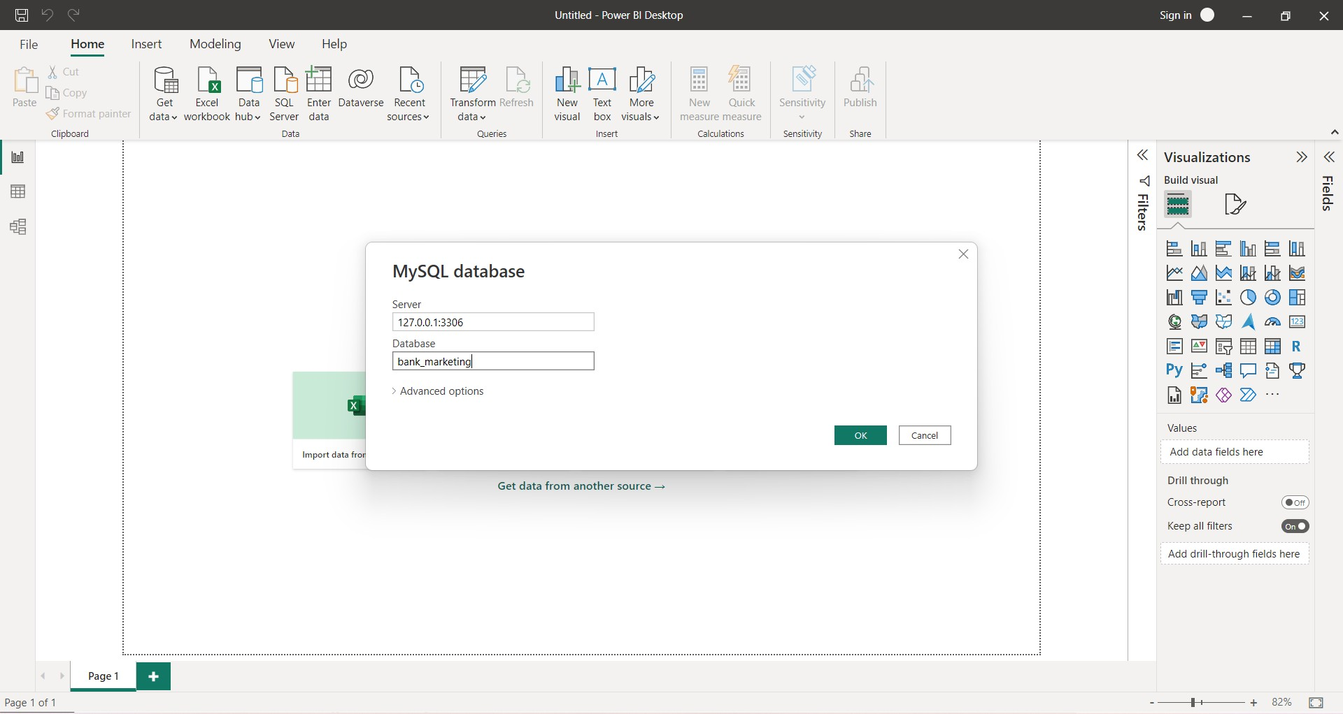
3.1 Data to Insights through Visualizations and Excel Data Analysis

Slide 12
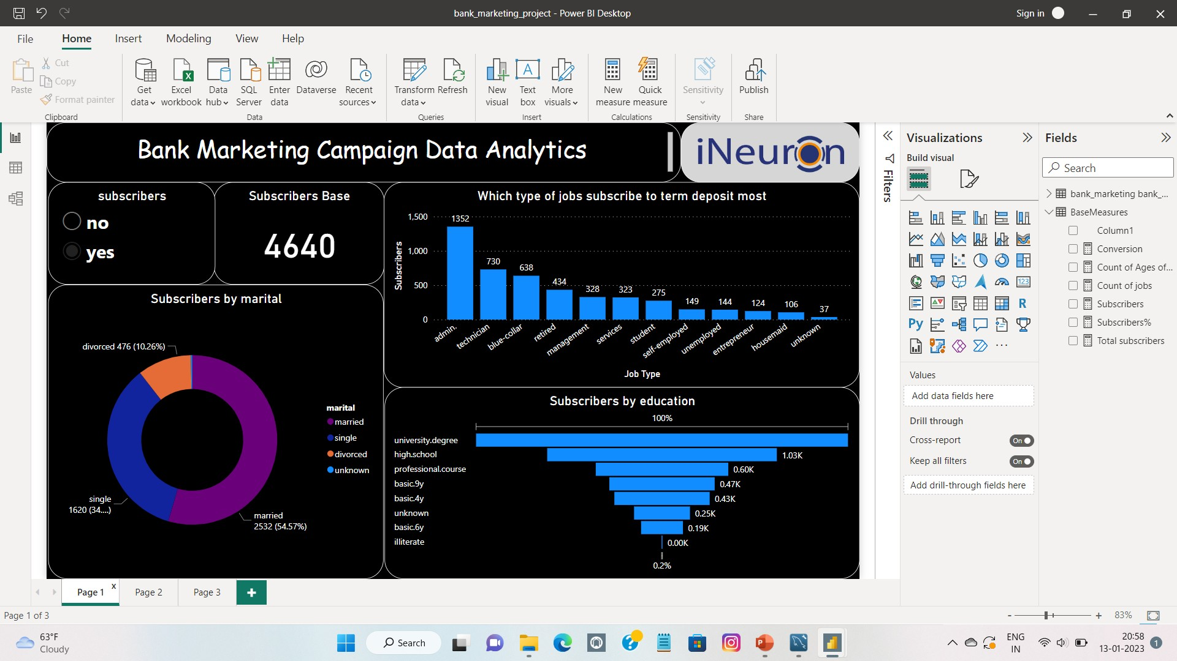
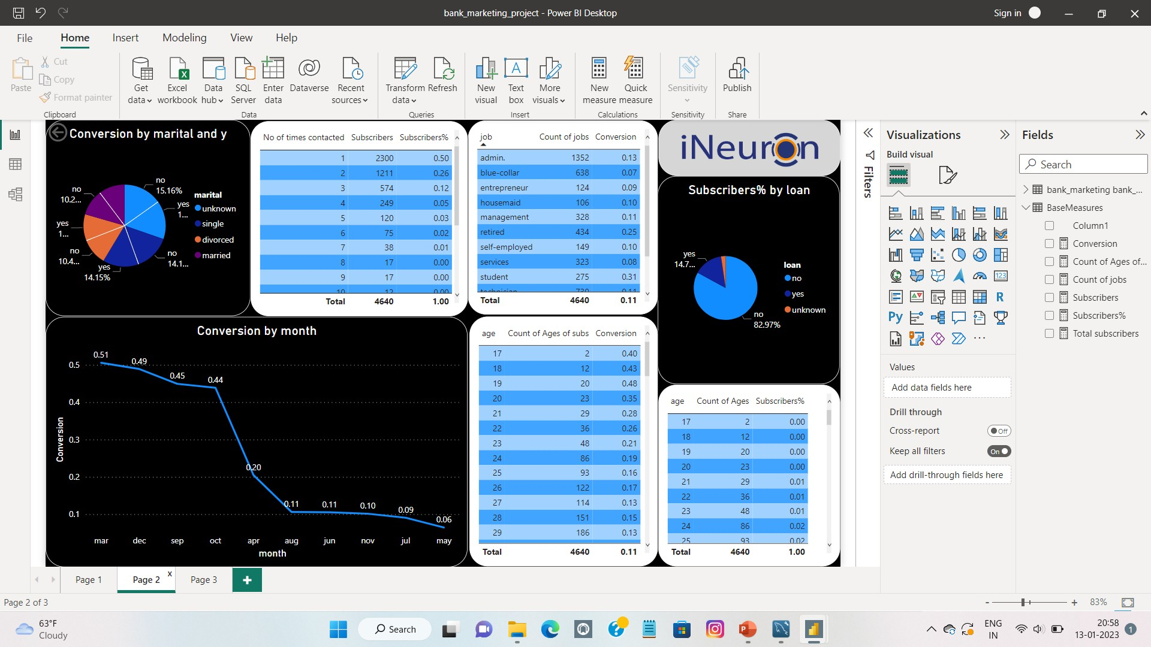

Slide 13
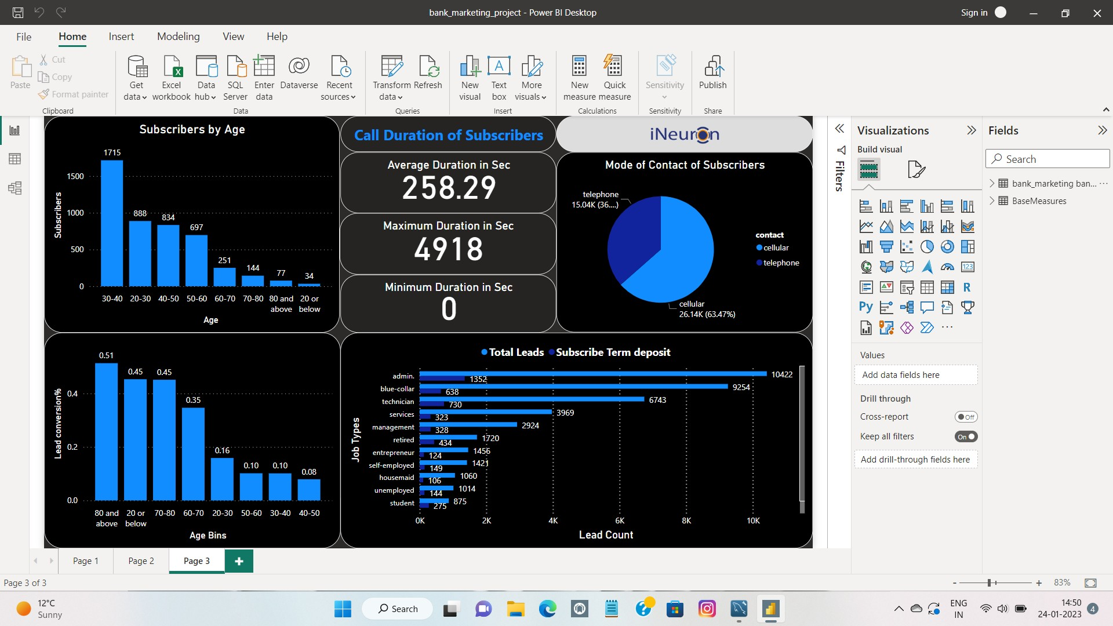
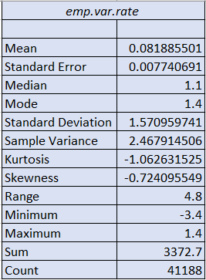
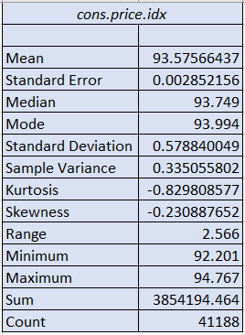

Slide 14
